Slide 1
HPC with Azure Batch and Azure DevOps

Slide 2
Important URLs
The Pipeline: https://dev.azure.com/russellemergentai/
The subscription: https://portal.azure.com/#home
Github for gridlib: https://github.com/russellemergentai/azure-test-batch-app
Documentation:
https://docs.microsoft.com/en-us/azure/batch/batch-ci-cd
https://docs.microsoft.com/en-us/azure/batch/batch-task-dependencies

Slide 3
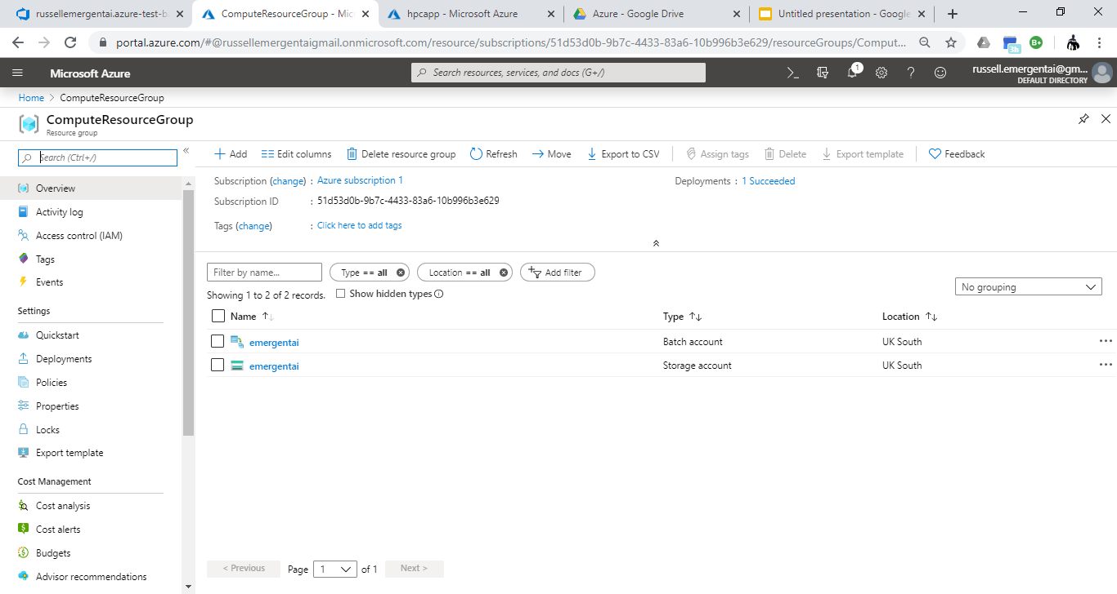
Azure subscription, batch account and storage account

Slide 4
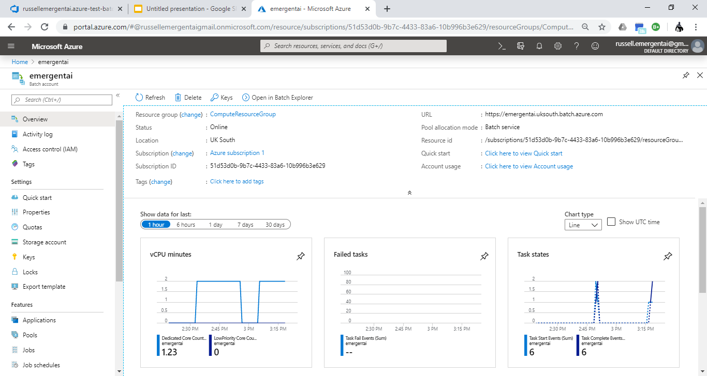
Profile of tasks running on Azure Batch

Slide 5
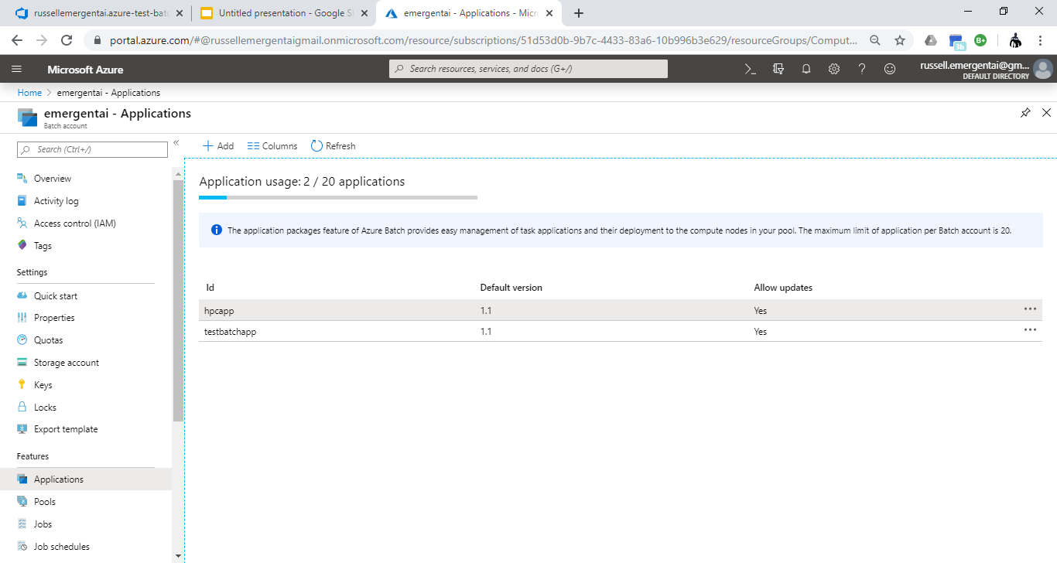
Application package deployed to Azure Batch

Slide 6
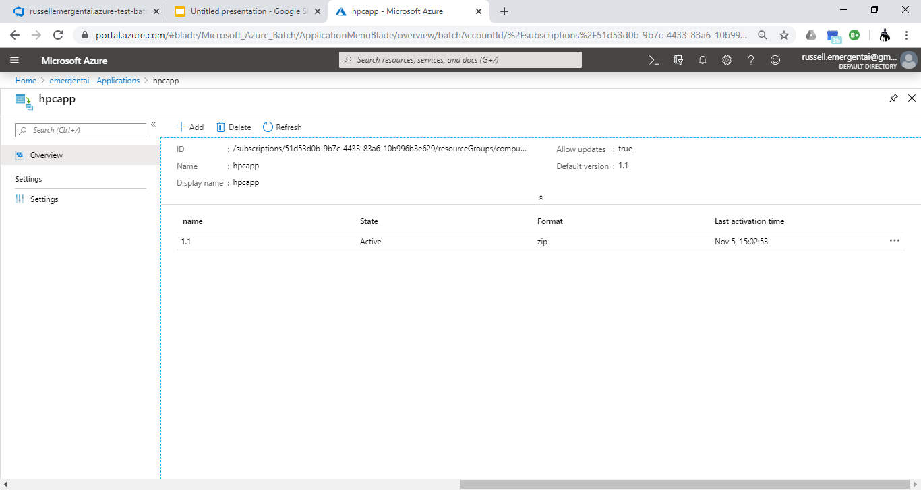
Details of Application package

Slide 7
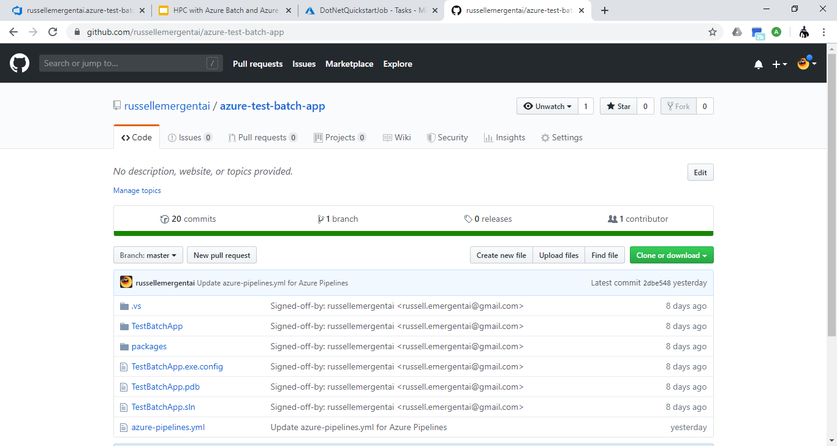
Github repository for gridlib, consumed from Azure Build

Slide 8
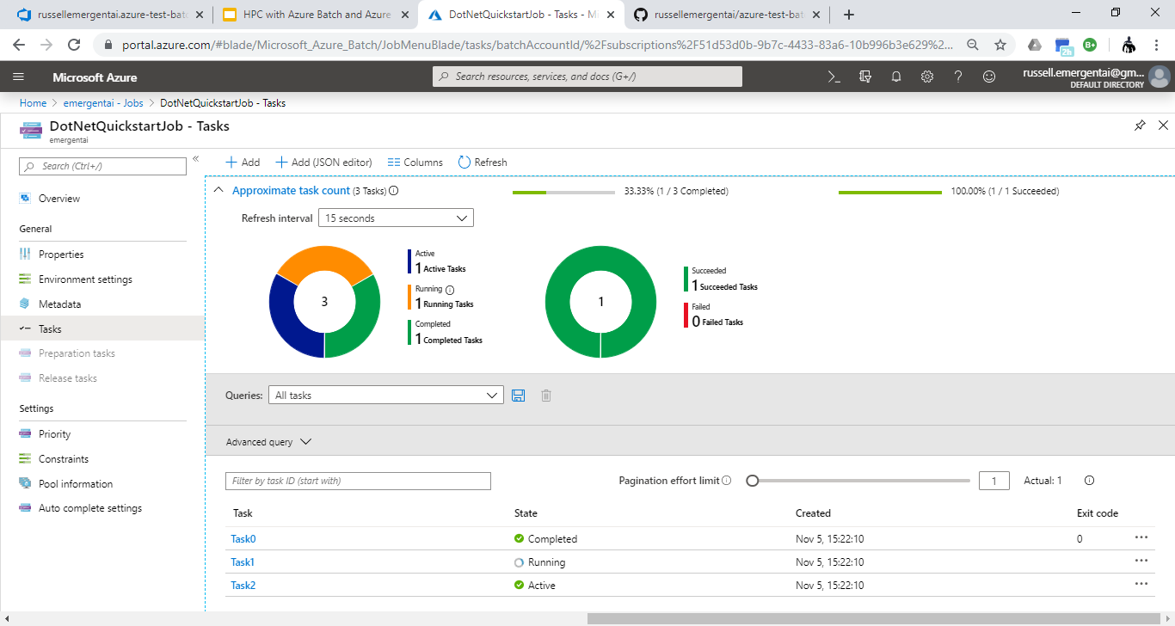
Azure batch running dependent tasks

Slide 9
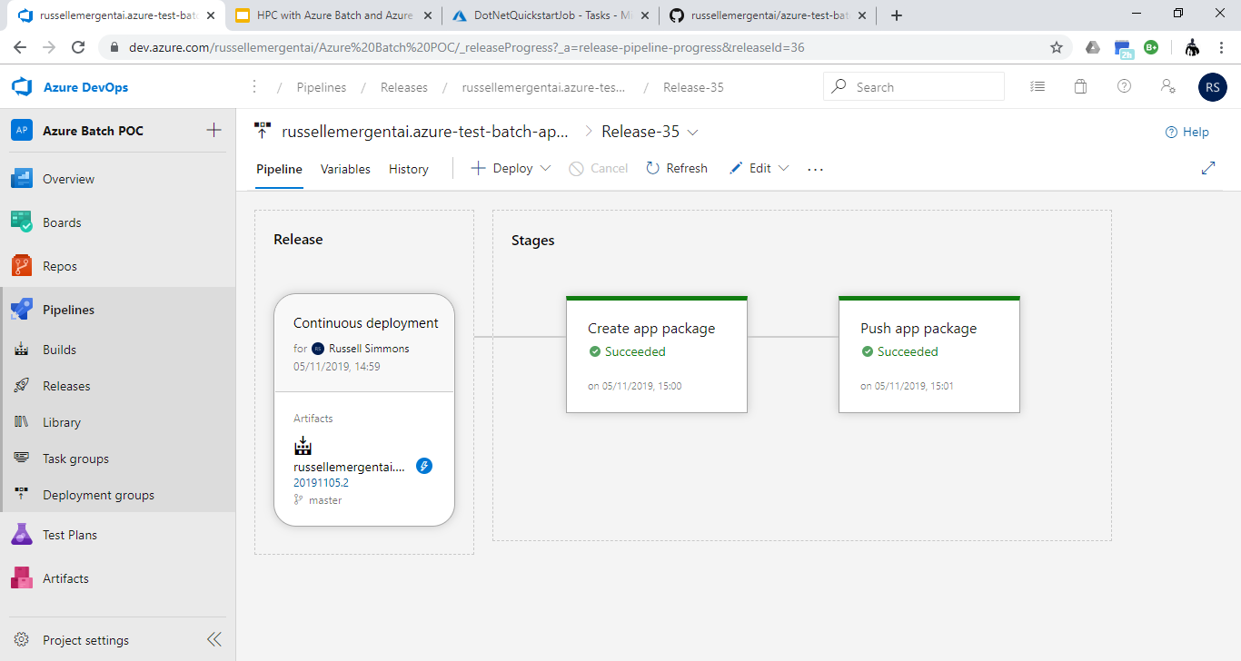
Azure Devops Pipeline

Slide 10
Azure pipeline build.yml
# Universal Windows Platform
# Build a Universal Windows Platform project using Visual Studio.
# Add steps that test and distribute an app, save build artifacts, and more:
# https://aka.ms/yaml
trigger:
- master
pool:
vmImage: 'windows-latest'
variables:
solution: '**/*.sln'
buildPlatform: ''
buildConfiguration: ''
appxPackageDir: '$(build.artifactStagingDirectory)\AppxPackages\\'
steps:
- task: NuGetToolInstaller@1
- task: NuGetCommand@2
inputs:
restoreSolution: '$(solution)'
- task: VSBuild@1
inputs:
platform: ''
solution: '$(solution)'
configuration: '$(buildConfiguration)'
msbuildArgs: '/p:AppxBundlePlatforms="$(buildPlatform)" /p:AppxPackageDir="$(appxPackageDir)" /p:AppxBundle=Always /p:UapAppxPackageBuildMode=StoreUpload'
# Zip up the files required in the Batch Account
- task: ArchiveFiles@2
displayName: 'Archive applications'
inputs:
rootFolderOrFile: testbatchapp/bin/Release
includeRootFolder: false
archiveFile: '$(Build.ArtifactStagingDirectory)/$(Build.BuildId).zip'
# Publish that zip file, so that we can use it as part
# of our Release Pipeline later
- task: PublishPipelineArtifact@0
inputs:
artifactName: 'hpcapp'
targetPath: '$(Build.ArtifactStagingDirectory)'

Slide 11
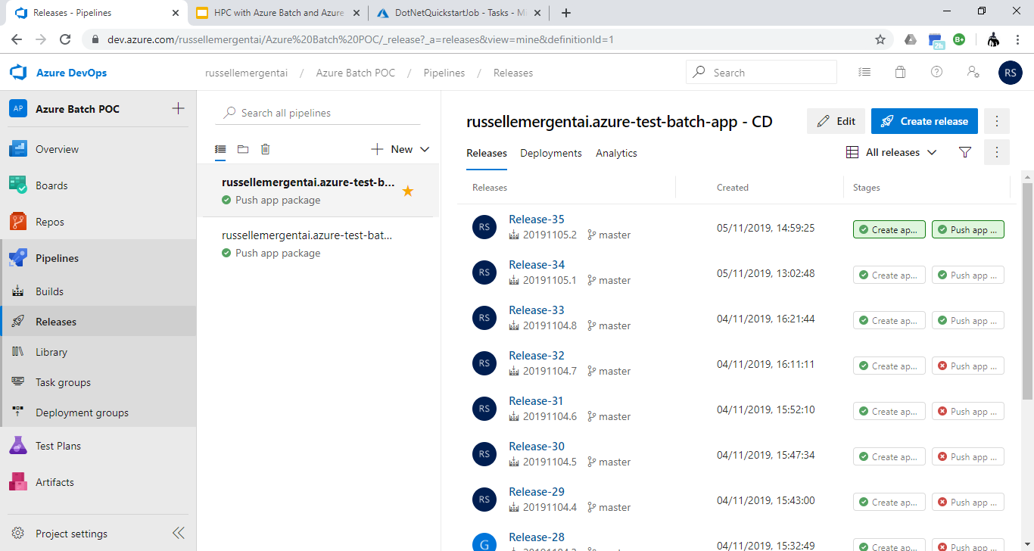
Azure pipeline home page

Slide 12
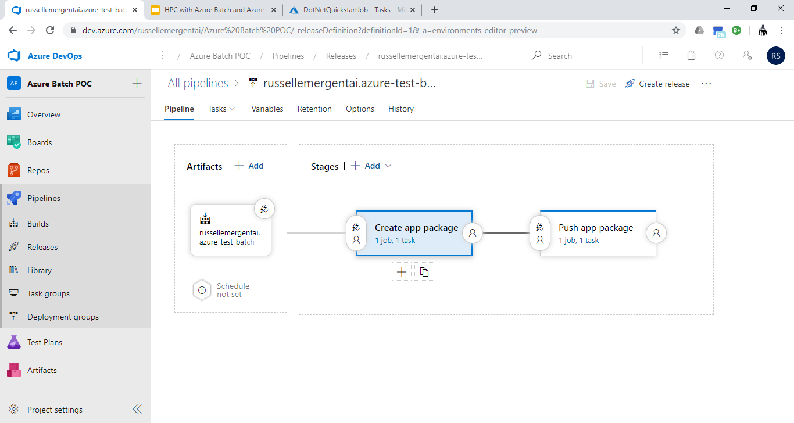
Azure pipeline graphic editor - Create app package task

Slide 13
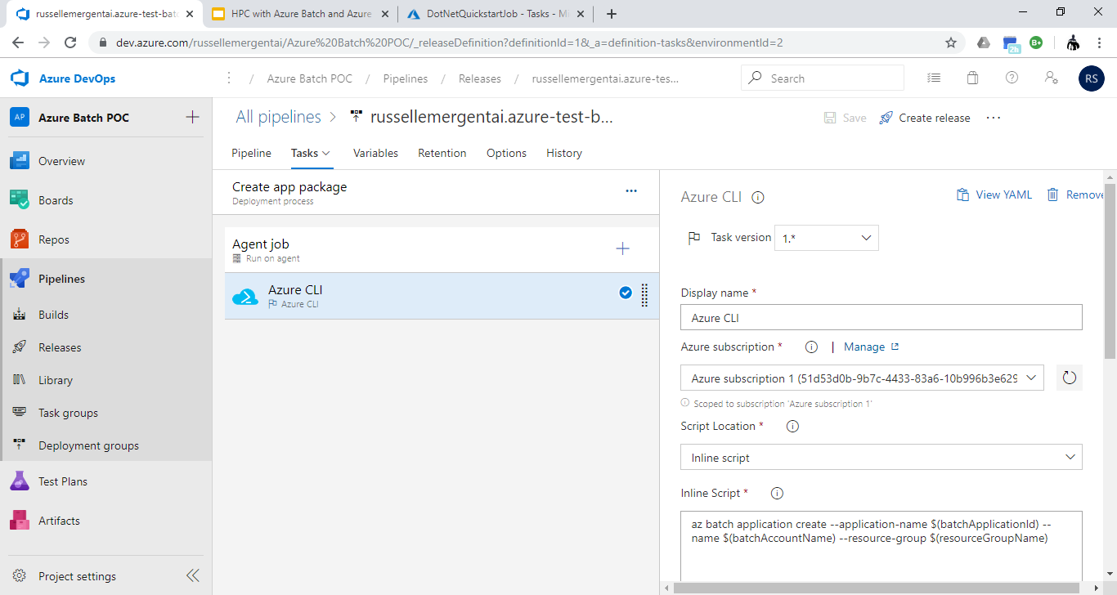
Create app package Azure CLI - inline script

Slide 14
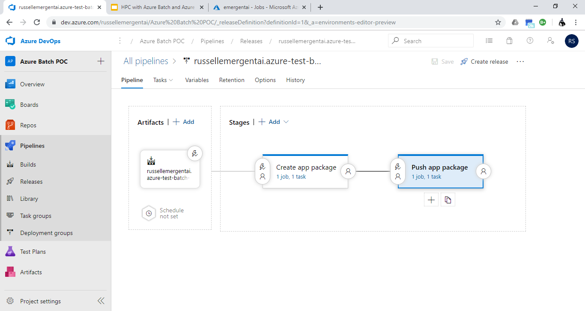
Azure pipeline - push app package task

Slide 15
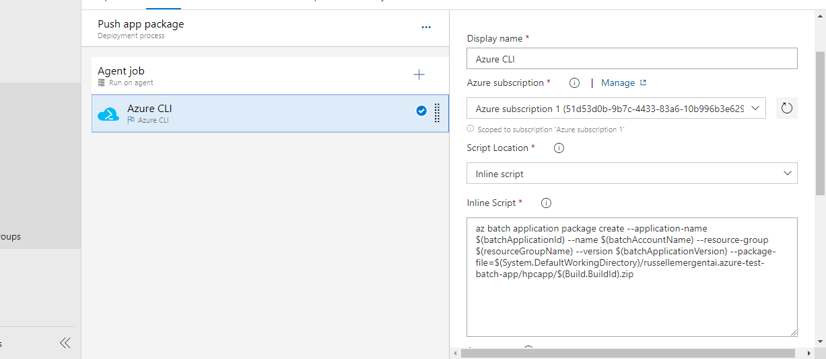
Push app package task - Azure CLI inline script

Slide 16
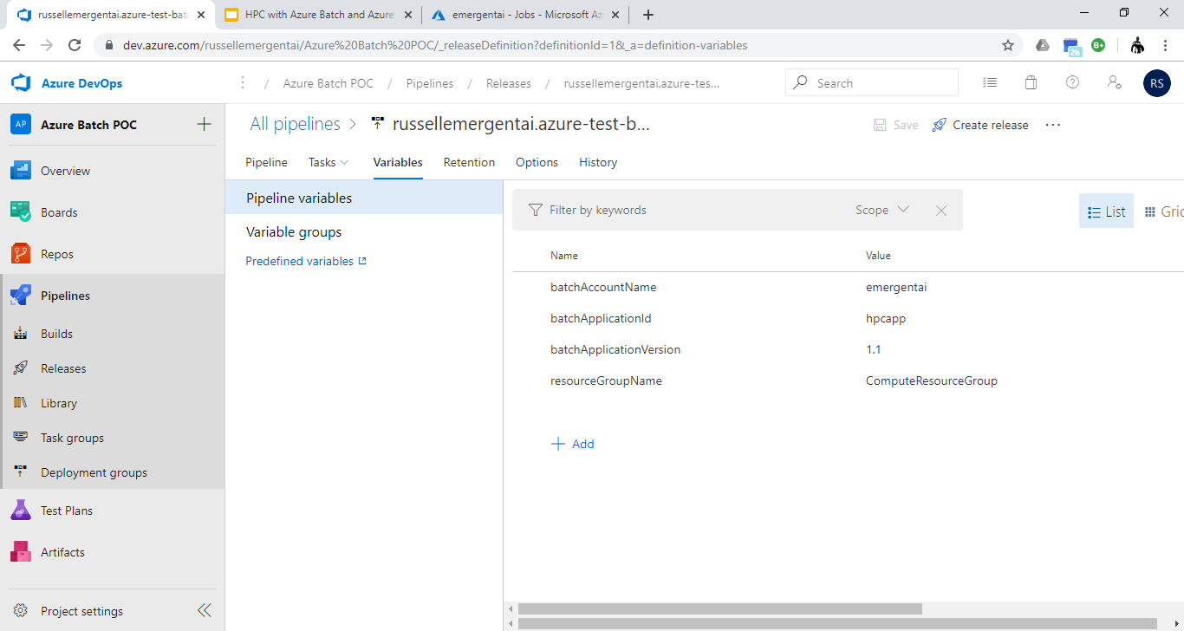
Azure pipeline variables

Slide 17
